Slide 1
The future of selection decisions and breeding programs: What are we breeding for, and who decides?
John B. Cole, PhD
PEAK Sr. VP for Research & Development
john.cole@urus.org

Slide 2


Thanks to my collaborators!
Dr. João Dürr, CEO, CDCB
Dr. Ezequiel Nicolazzi, COO, CDCB

Slide 3
Take-home messages – 1
Genetic selection has been a very successful tool for the long-term improvement of livestock populations.
Full expression of genetic potential requires that animals be placed in environments that can support such performance.
Updates to NM$ require the estimation of many different parameters, and it can be difficult to achieve consensus from ARS, CDCB, industry, and university experts on what should be added or removed from the index at each review.

Slide 4
Take-home messages – 2
Much of the emphasis in the index has shifted over time from yield traits to fertility, health, and fitness traits, mirroring changes in production economics.
Phenotypes for many of these new traits are difficult or expensive to measure.
New sensor-based systems provide new ways of measuring animal performance and the farm environment.

Slide 5
Introduction
Background on selection goals
Development of selection objectives
Opportunities and challenges
Some brand new results

Slide 6
Background on selection goals

Slide 7
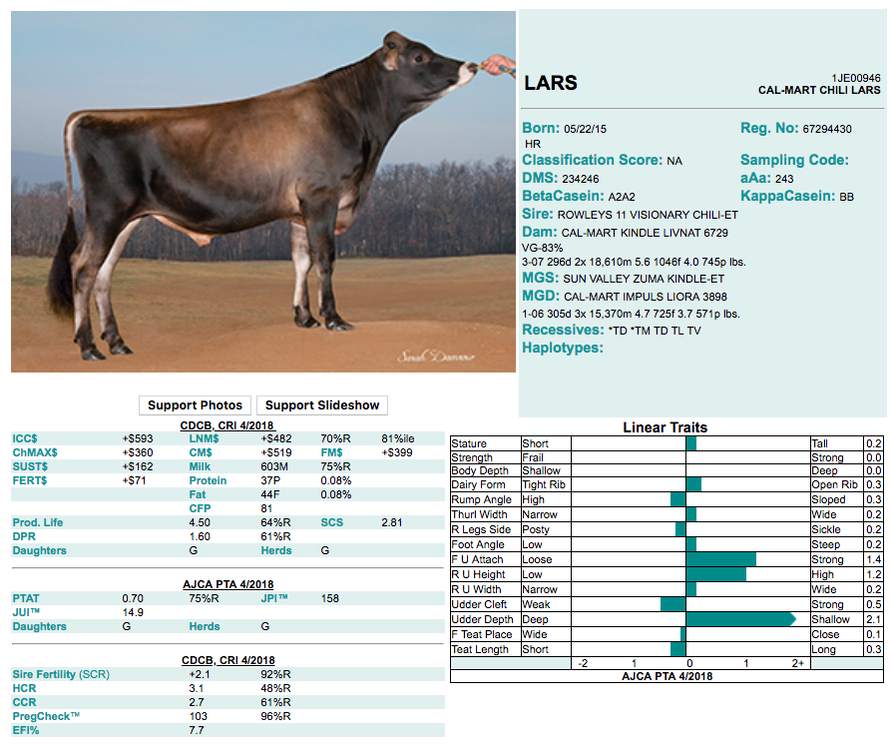
What is a selection index?
A single number based on information about many traits used for making selection decisions
ICC$ = Ideal commercial
cow index
LNM$ = Lifetime net merit
FM$ = Fluid merit
CM$ = Cheese merit
JPI = Breed-specific index

Slide 8
Indices may include sub-indices
Sub-indices summarize data so that breeders do not have to know details of every trait (31 in NM$)
NM$ = Production $ + Longevity $ + Fertility $ + Type $ + Calving $
Milk
Fat yield
Fat %
Protein yield
Protein %
Productive life
Cow livability
SCS
Daughter pregnancy rate
Heifer conception rate
Cow conception rate
Feet & legs (4)
Udder (7)
Body size (5)
Calving ease (2)
Stillbirth rate (2)

Slide 9
Why select for more than one trait?
To make use of more information
Correlations among traits are rarely 0
Several traits may have economic value
Farmers may receive a quality premium
Some traits need to be improved and others maintained
Selection for only yield would reduce fertility
Balanced selection improves traits according to their economic values

Slide 10
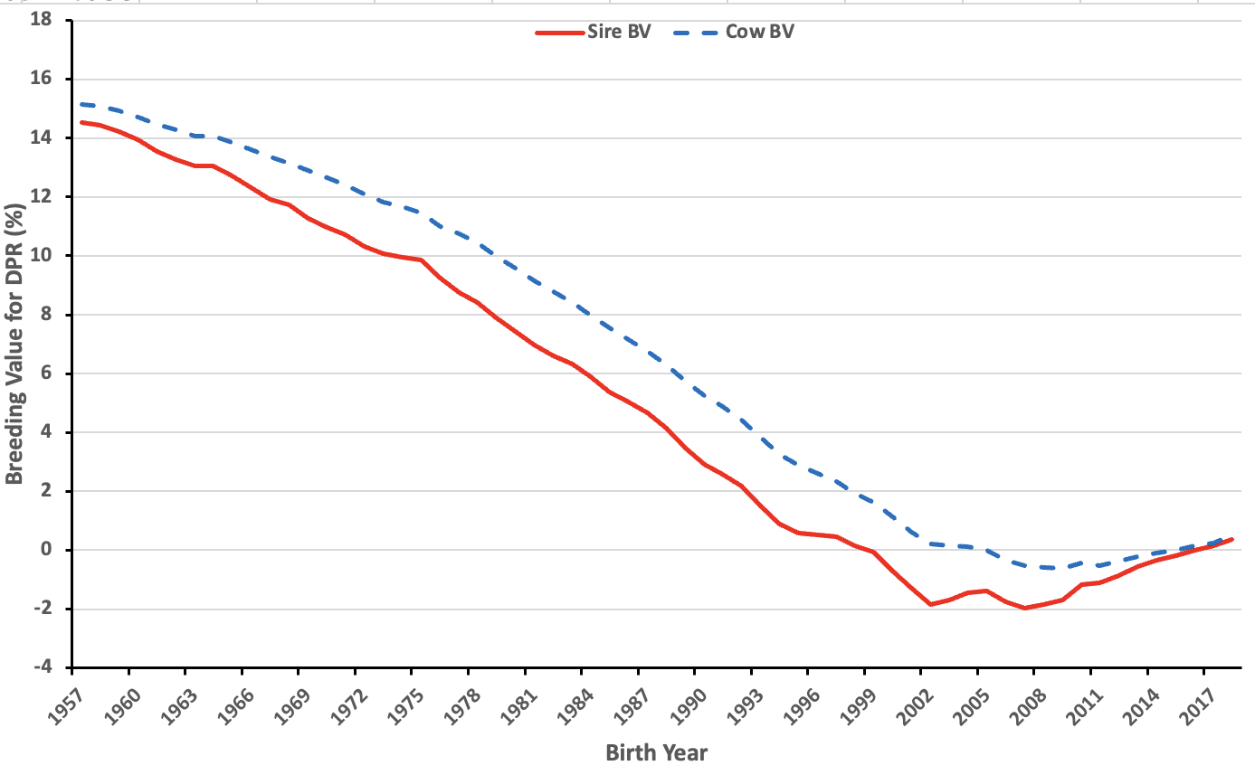
Selection for only yield reduces fertility

Slide 11
Development of selection objectives

Slide 12
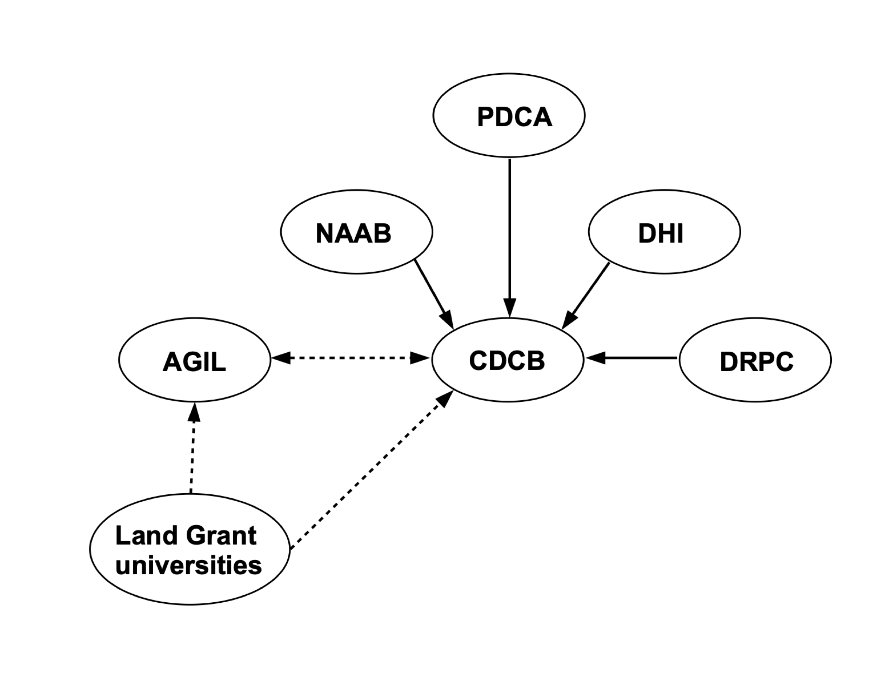
Who are the participants?

Slide 13
How are index decisions made?
Periodic updates are necessary
Economics change, as does our knowledge of biology
The NM$ weights are probably based 95% on mathematics and 5% on consensus of experts
Not matter how “scientific” we want this process to be, there’s always going to be some art to it, too
Computing incomes and expenses is very difficult!

Slide 14
Who owns the index?
Nobody really owns NM$, it’s a shared resource.
Responsibility for the national cooperators database and the genetic evaluation system was passed from USDA to CDCB in 2013.
USDA and CDCB share the responsibility for keeping NM$ and its companion indices up-to-date.
There are a number of proprietary selection tools that are owned by breeding companies and purebred cattle associations.

Slide 15
Selection objectives and criteria
The selection objective is the set of traits that we wish to improve
e.g., lifetime profitability
The selection criterion is the set of traits that we measure and use to make selection decisions
e.g., milk yield, daughter pregnancy rate, body size composite
Traits may appear in both the objective and the criterion

Slide 16
What goes into an index?
P
C
G
a
Phenotypic (co)variances among traits in the criterion
Genetic (co)variances among traits in the objective
Genetic (co)variances among traits in the criterion and objective
Economic weights

Slide 17
Where do economic weights come from?
Quantitative analysis
Research and field reports to quantify incomes and expenses
Driven by empirical factors
Used in the calculation of NM$
Qualitative analysis
Target for breed improvement developed by experts
Driven by empirical and subjective factors
Used in the calculation of some breed society indices

Slide 18
How do we compute an index?
b
P^{–1}
G
a
= × × ×

Slide 19
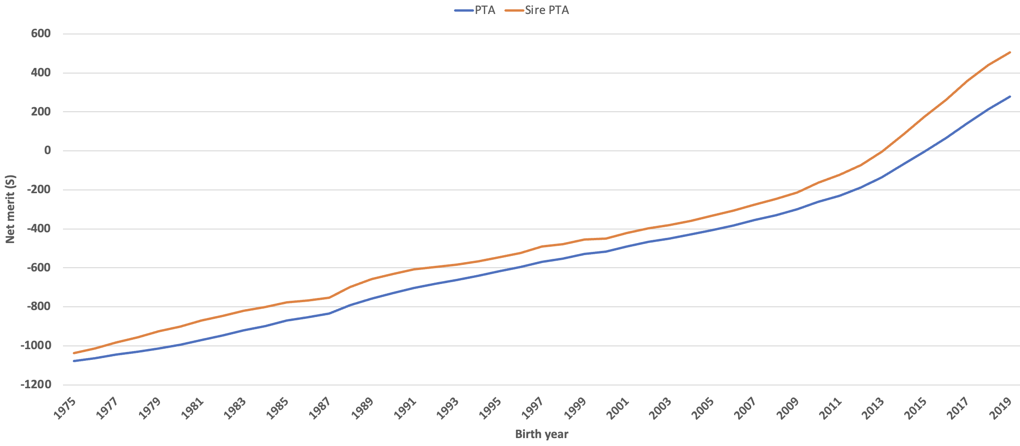
Genetic trend

Slide 20
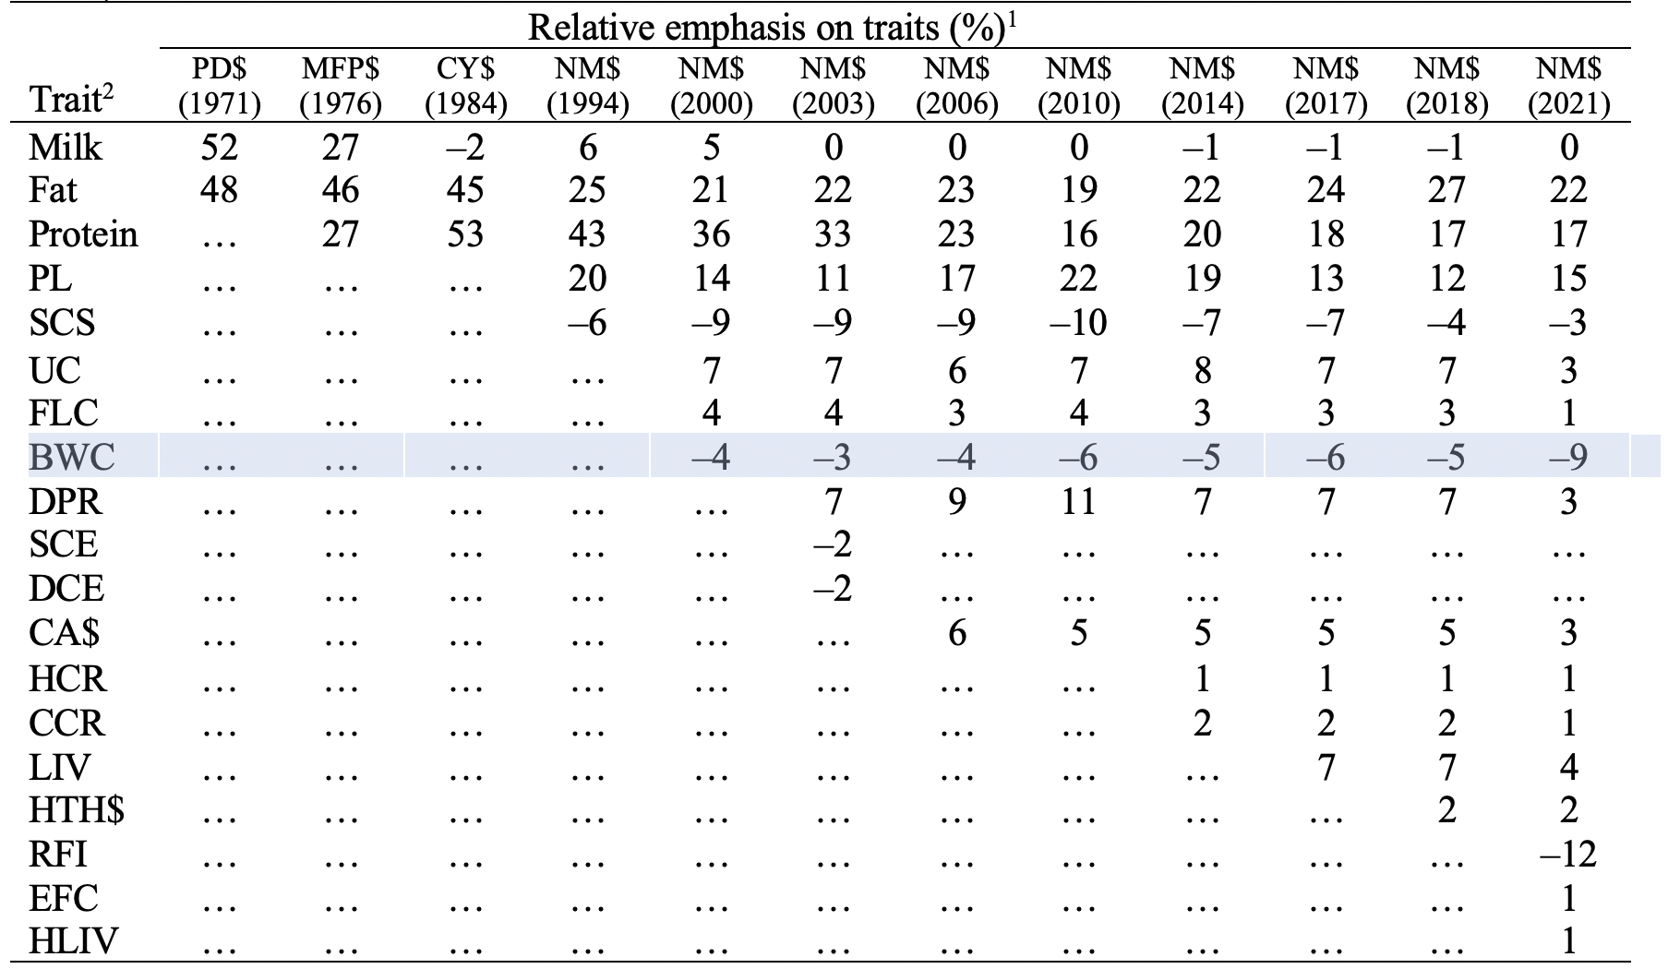
How has the index changed over time?

Slide 21
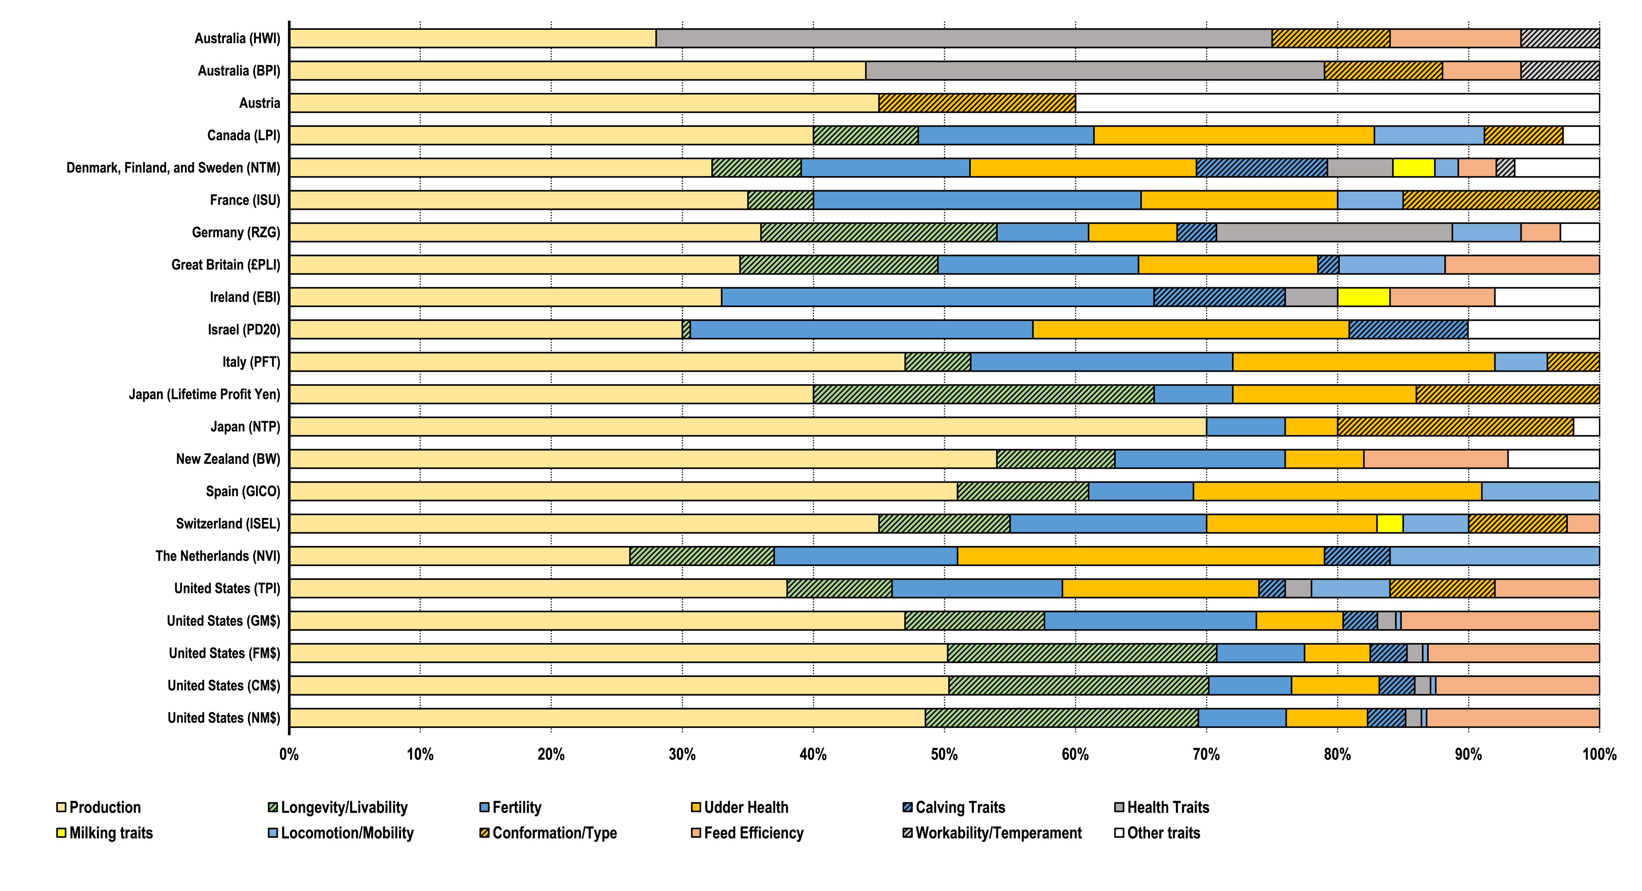
How does NM$ compare to other indices?

Slide 22
Opportunities and challenges

Slide 23
Are we accounting for the environment?
P = G + E
Additive effects
Dominance effects
Epistasis
Housing
Climate
Unknown
What about G×E?
Effects generally small in the US (e.g., Wright and VanRaden, 2015)

Slide 24

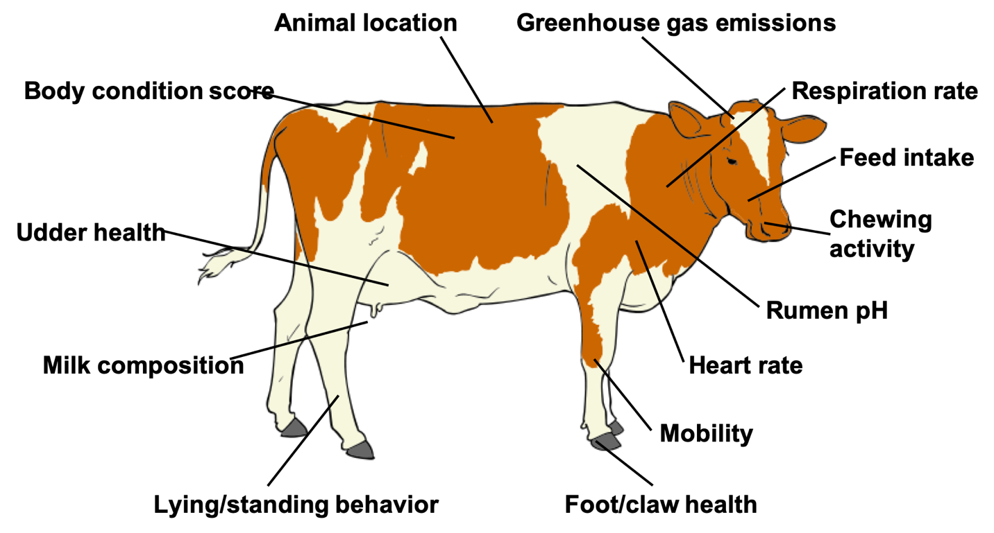
Phenotype is king!
Source: Cole et al. (2020; PMID: 32257602) after Figure 5 of Halachmi et al. (2019, PMID: 30485756).

Slide 25
Why do we need new phenotypes?
Changes in production economics
Technology produces new phenotypes or reduces costs of collecting them
New traits can be predicted on all genotyped animals without collecting progeny records
Phenotyping costs are shared among millions of animals
Better understanding of biology
People are harder to find than data!

Slide 26
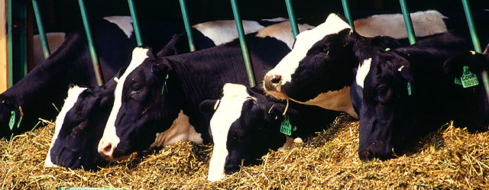
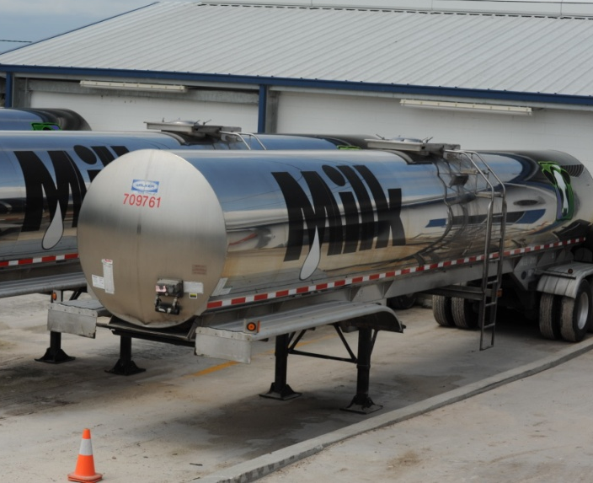
Traditional phenotyping scheme
Current milk recording
Many farms participate
Low-intensity phenotyping (few measurements per cow)
Well-suited to traits with low recording costs
Source: ARS, USDA
Source: North Florida Holsteins
Source: John B. Cole

Slide 27
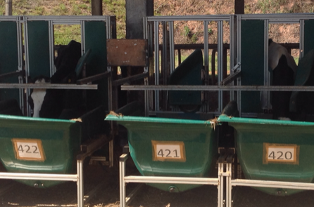
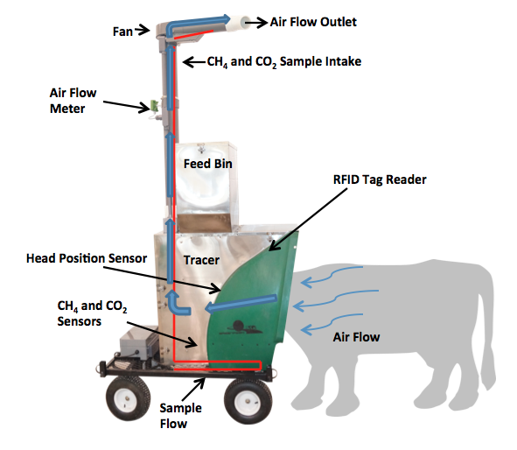
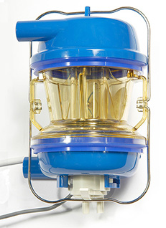
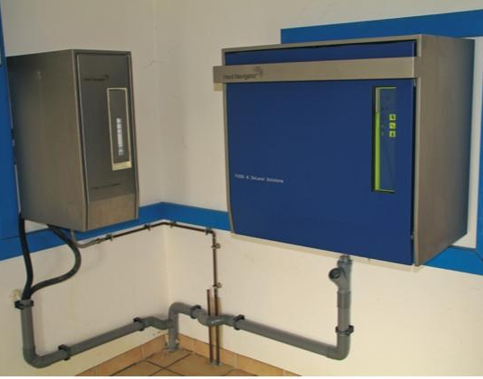
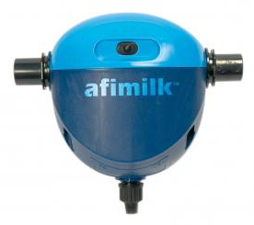
Alternative phenotyping scheme
Few farms
Intensive phenotyping (many measurements per cow)
Use cases
Expensive-to-measure traits
Developing countries
Private indices?
Source: John B. Cole
Source: http://c-lockinc.com/
Source: http://www.afimilk.com/
Source: http://goo.gl/wu8YtR

Slide 28
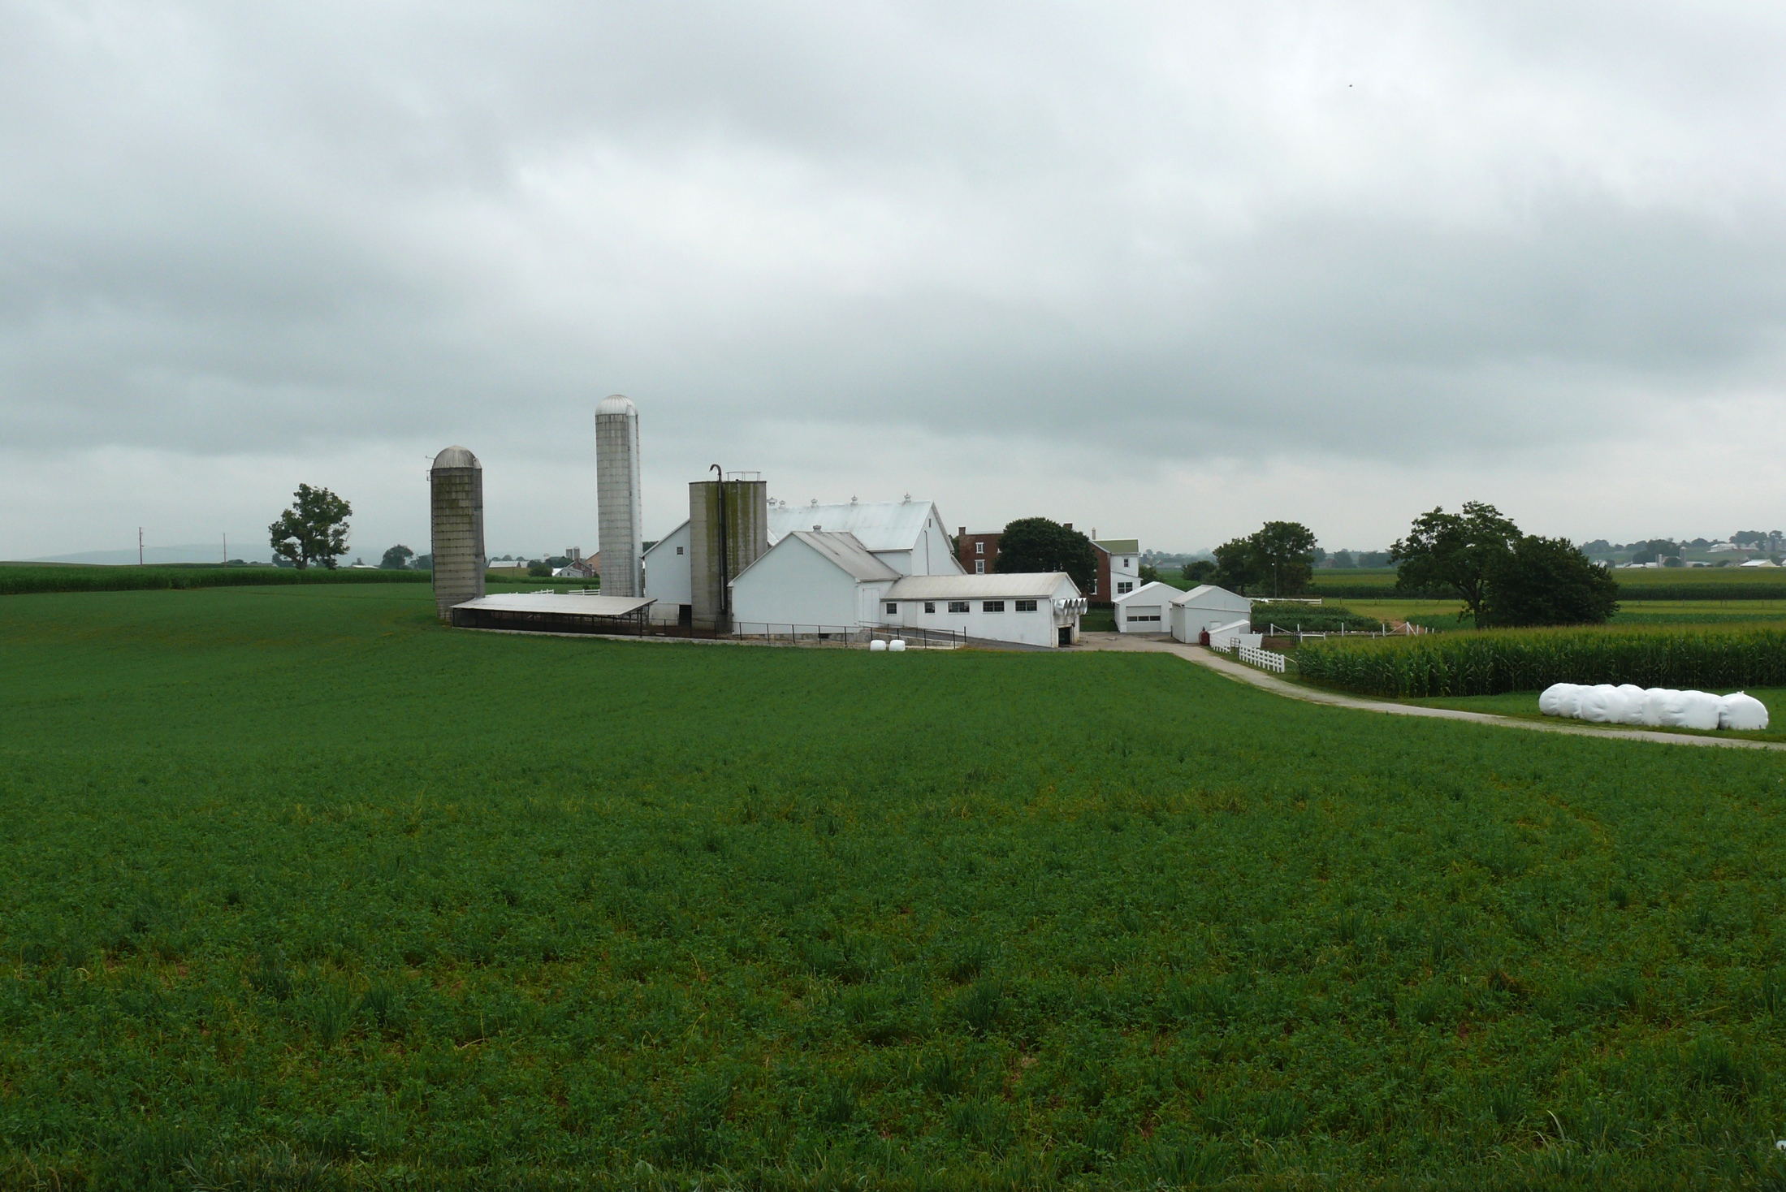
What about the outside of the cow?
Barn: Flooring type, bedding materials, density, weather data
Herdsmen/consultants: Health events, foot/claw health, veterinary treatments
Parlor: yield, composition, milking speed, conductivity, progesterone, temperature
Silo/bunker: ration composition, nutrient profiles
Pasture: soil type/composition, nutrient composition
Laboratory/milk plant: detailed milk composition, mid-infrared spectral data
Source: http://commons.wikimedia.org/wiki/File:Amish_dairy_farm_3.jpg

Slide 29
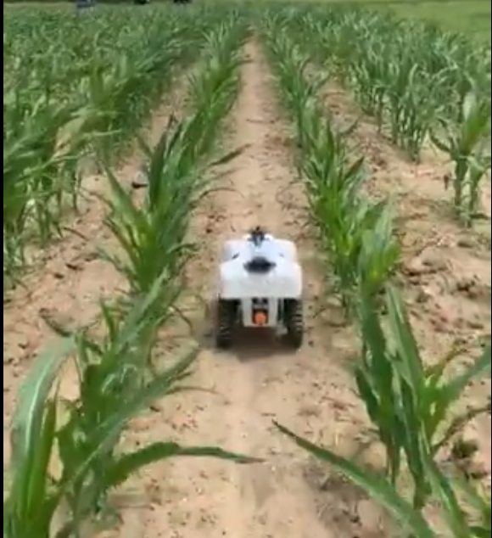

Next-generation phenotyping?
How I imagine it…
How it may turn out…
Source: Aimee Schulz (@aimeejschulz)
Source: Skaro Ministry of Science/BBC One

Slide 30
Some new results!

Slide 31
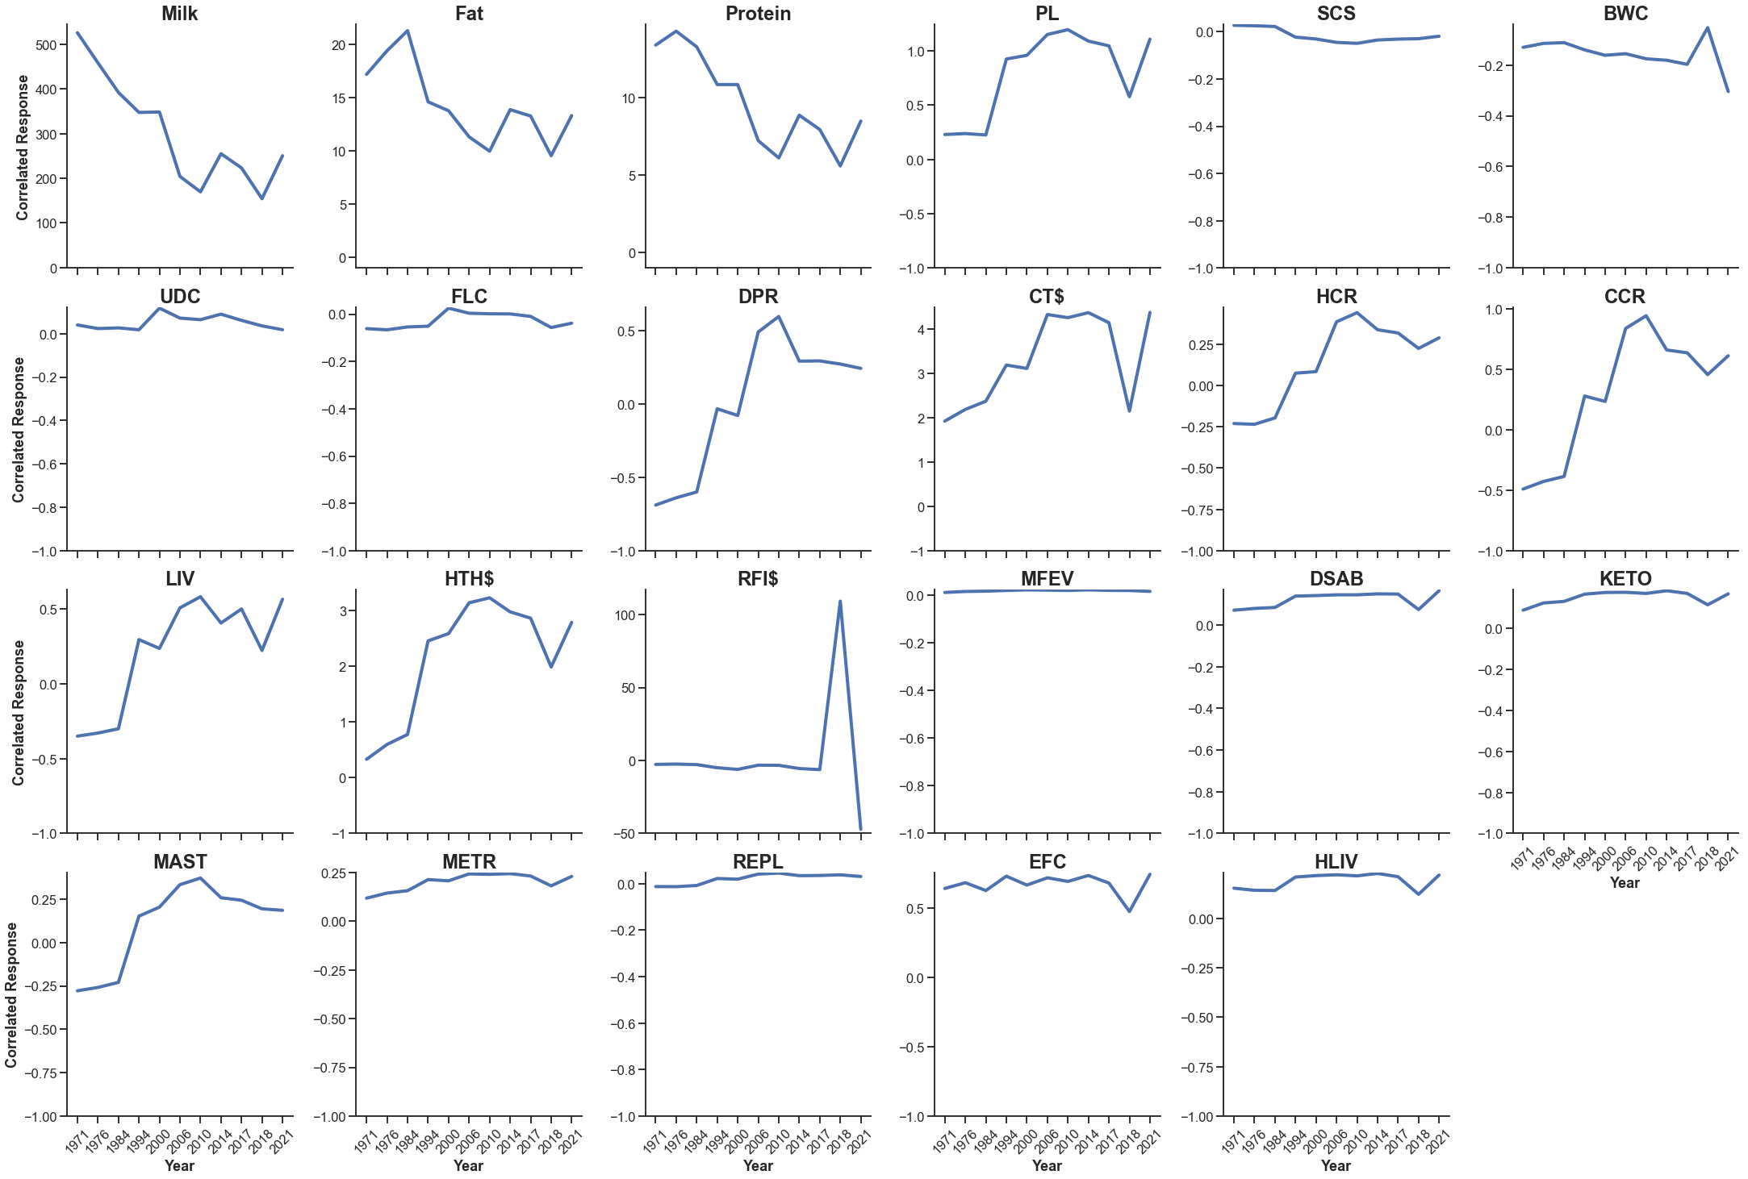
Changes in genetic gain over time

Slide 32
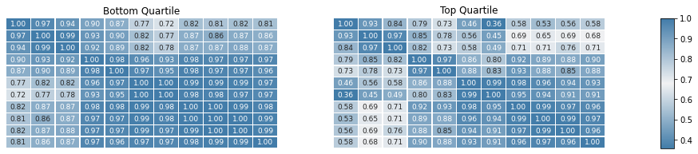
Are high NM$ animals more “diverse”?

Slide 33
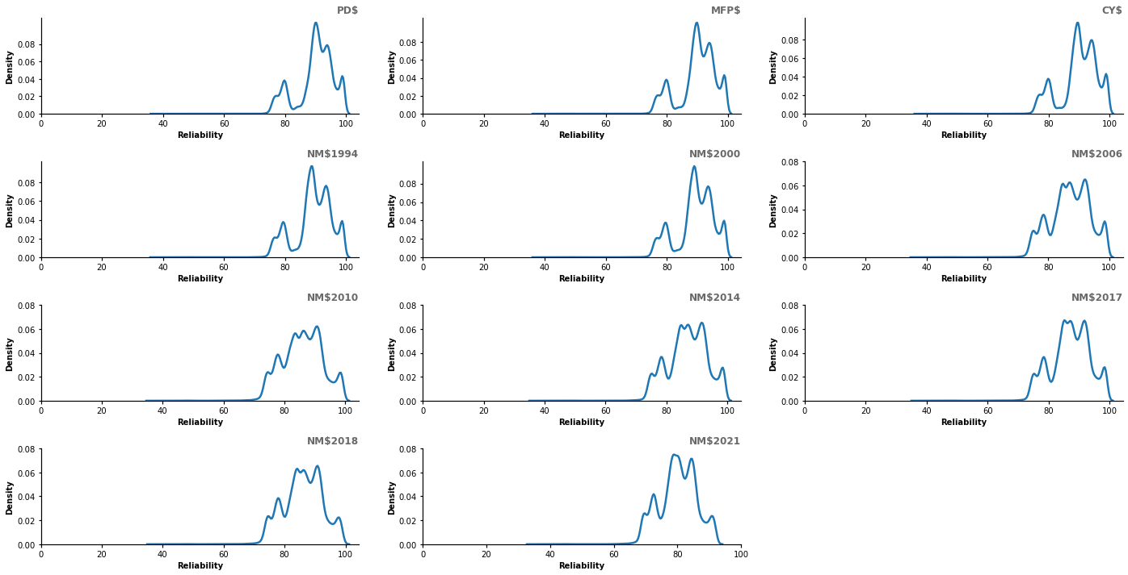
Changes in reliability

Slide 34
Conclusions
Change used to be gradual, providing time for people to adapt at a comfortable pace.
Many sources of information exist now, many lacking validation, and their value is not always clear.
The rate of change is rapid and farmers need objective sources of transparent information more than ever before.
The best way for the industry to meet the needs of the dairy producers is to treat genetic evaluations as a shared good for the benefit of all.

Slide 35
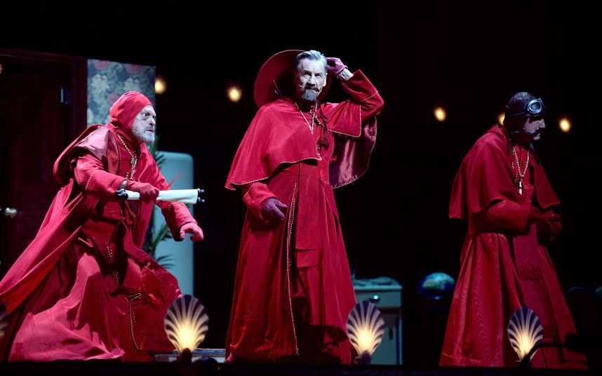
Questions?

